Slide 1
Office 365 development

Slide 2
Deep Dive into Office 365 APIs for SharePoint Site services

Slide 3
Agenda
Overview
File operations with SharePointClient class
List operations with REST
Azure AD & CSOM

Slide 4



Office Platform
WHAT CAN I BUILD?
ADD-INS AND WEB PARTS:
Make your solution a native part of the modern Office
WEB AND DEVICES APPS:
Build smarter apps by connecting to Office services
VOICE, VIDEO, CONNECTORS, AND BOTS
Create the next generation of productivity solutions

Slide 5
1
Overview

Slide 6
SharePoint Sites Services
Provides access to SharePoint online REST API
SharePointClient class simplifies programming, but limited functionality
Direct REST API calls more complex, but exposes more functionality
Notes:
The purpose of this module is to show how you can access the complete SharePoint REST API
The SharePointClient only has access to Files, but we can get an Access Token via the Discovery Service for use with REST calls.

Slide 7
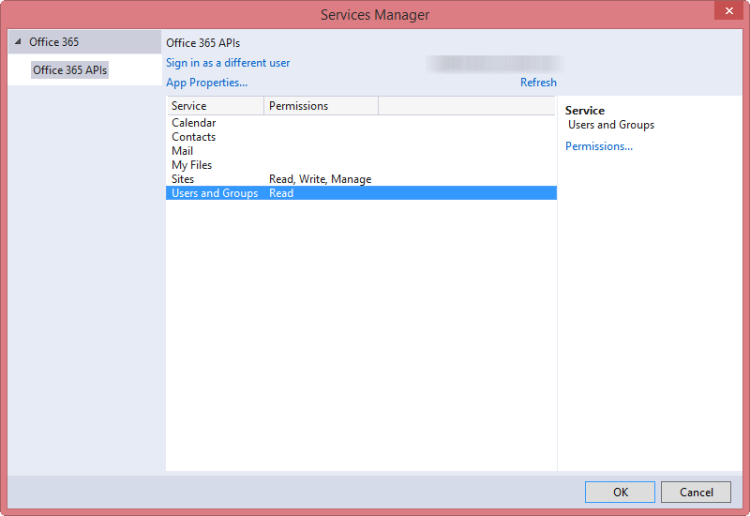
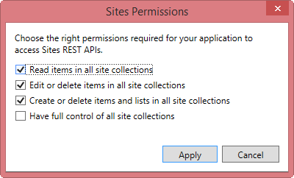
Permissions
Notes:
Just to show the various permissions that are available

Slide 8
2
File Operations with SharePointClient

Slide 9
SharePointClient class
Get an Access Token for the specific resource
Create SharePointClient instance
SharePointClient.Files abstracts Files API
Notes:
The discovery service discovers the SharePoint resource, which we can use to access document libraries

Slide 10

Reading File Metadata
Read Files collection
Can also read an individual Folder
Paging is accomplished post-query using LINQ
Notes:
No support for $skip and $orderby so paging is post-query

Slide 11
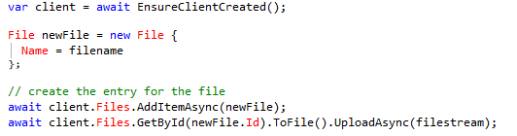
Uploading a new File
Use AddItemAsync method
Provide a file name and the file stream

Slide 12

Deleting a File
Get the target file using GetByAsync method
Delete using DeleteAsync method

Slide 13
File operations with the SharePointClient
2 File operations
Demo

Slide 14
3
List operations with REST

Slide 15
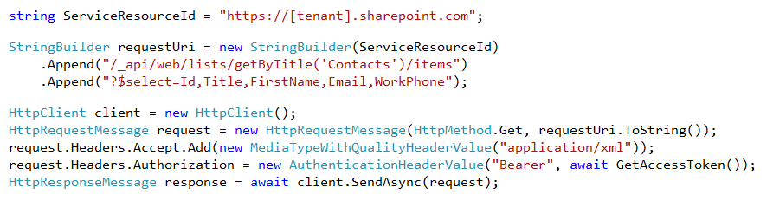
Reading List Items
Access the SharePoint REST API with the Access Token
Notes:
No support for $skip and $orderby so paging is post-query

Slide 16
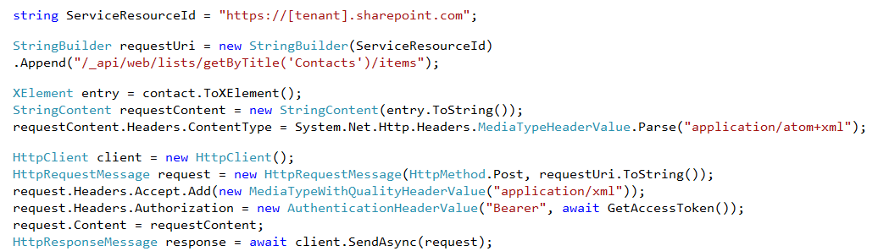
Adding a New List Item
Create message with list item data
POST to list items endpoint

Slide 17
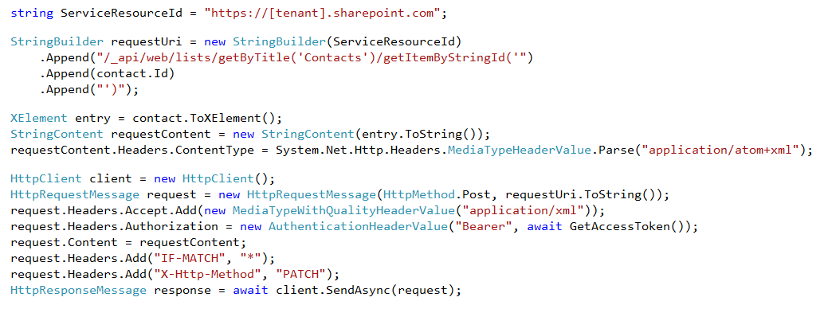
Updating a List Item
Create message with list item data
POST to target item ID
Notes:
Notice how the FormDigest isn’t passed
We get all the permissions we need from Azure Active Directory

Slide 18
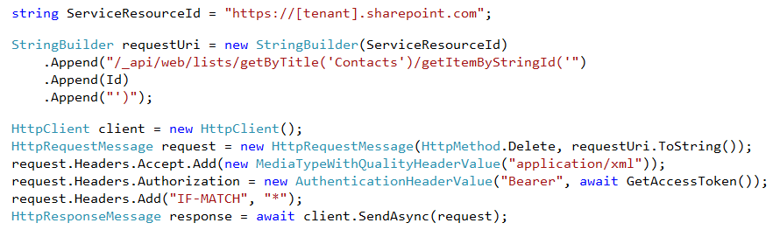
Deleting a List Item
DELETE the target item by ID
Supports the use of eTags

Slide 19
List Operations with REST
3 List operations with REST
Demo

Slide 20
4
Azure AD & CSOM

Slide 21
Reading List Items
Access the SharePoint REST API with the Access Token
Notes:
No support for $skip and $orderby so paging is post-query

Slide 22
SharePoint Scope Convergence
Most common workloads permissions supported in Azure AD applications
Additional workloads (aka: scopes) constantly being added to Azure AD
Managed Metadata
Search

Slide 23
SharePoint APIs
SharePoint offers two APIs
REST API
CSOM
Both APIs accept OAuth access tokens from Azure AD

Slide 24

Some Scopes only Supported in CSOM
Managed metadata only exposed in CSOM, not in REST API
Can use Azure AD based access tokens in CSOM calls

Slide 25
Working with Managed Metadata, Azure AD & CSOM
3 List operations with REST
Demo

Slide 26
Summary
Overview
File operations with SharePointClient class
List operations with REST
Azure AD & CSOM

Slide 27
Further reading…
SharePoint Code Samples
SharePoint Training videos & hands on labs
SharePoint documentation
SharePoint patterns and practices solution guidance

Slide 28
Engage

